Slide 1
ENHANCEMENT PROGRAM

Slide 2
Outline :
Introduction to Light emitting diode(LED), RGB LED
LED displays – 7 segment display, Bargraph, Dot matrix
Light dependent Resistor (LDR)
Servo motor
Relay
Buzzer
Keypad

Slide 3
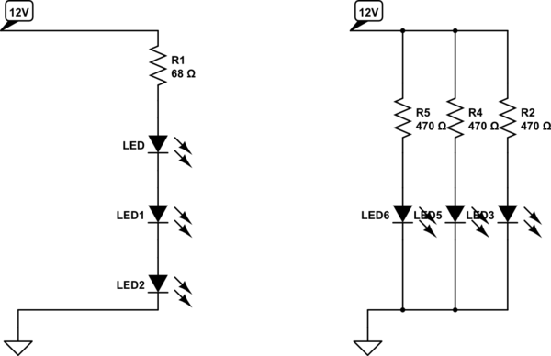
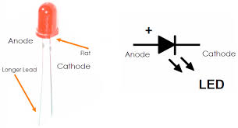
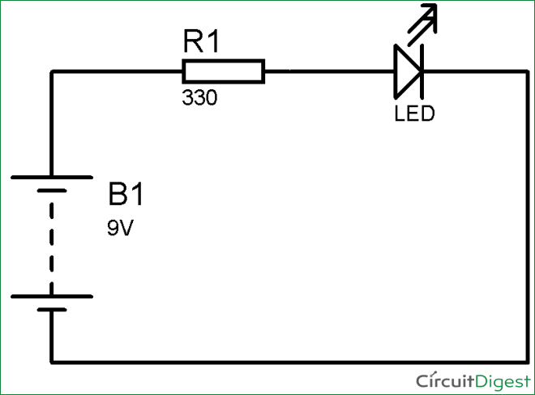
Light Emitting Diodes
https://www.tinkercad.com/things/9HHkIGA9I2V-glorious-fyyran/editel?tenant=circuits?sharecode=qbbMS2QR4W-qhUULOcUvuS7kVFKgU8zSN9IsYXAygyo

Slide 4
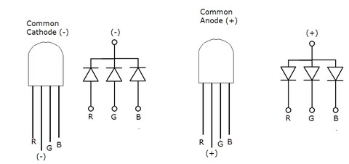
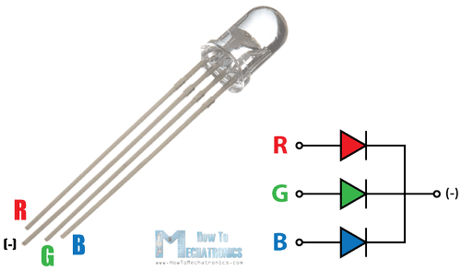
RGB LED
An RGD LED is an LED that can light up either red, green or blue.
https://www.tinkercad.com/things/cxaZrQXJYQg-amazing-hillar/editel?tenant=circuits

Slide 5
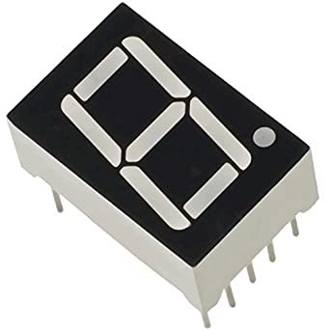
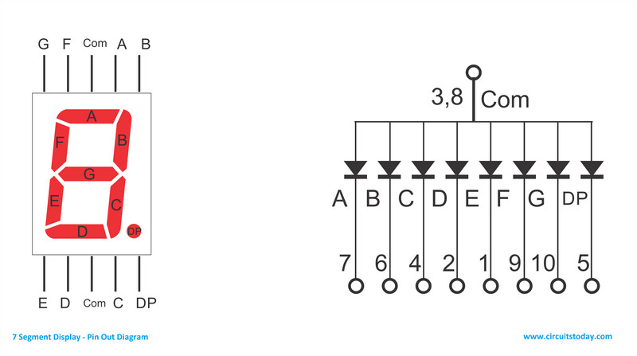
7 Seven segment LED display :
Seven segment display consists of seven LEDs arranged in the rectangular fashion. Each of the seven LEDs called segment because when illuminated the segment forms part of the numerical digit to be displayed.
The segments of a 7-segment display are referred to by the letters A to G, where the optional decimal point (an "eighth segment", referred to as DP) is used for the display of non-integer numbers.

Slide 6
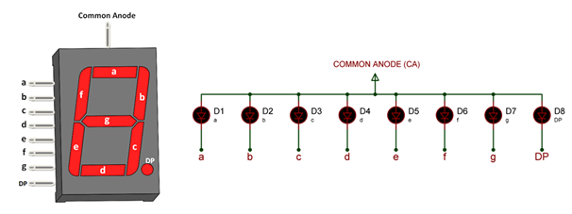
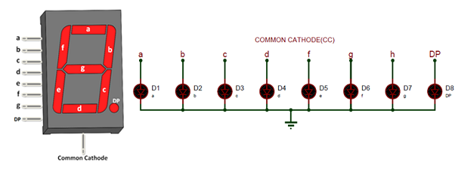
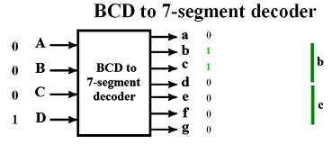
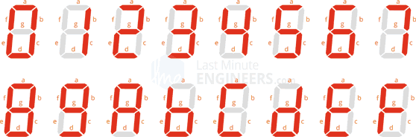
Common Anode configuration Common Cathode configuration

Slide 7
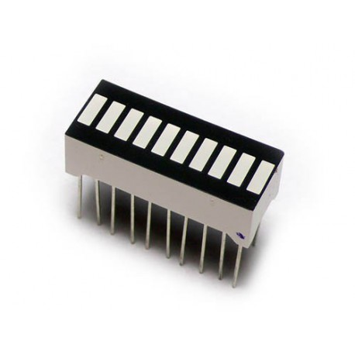
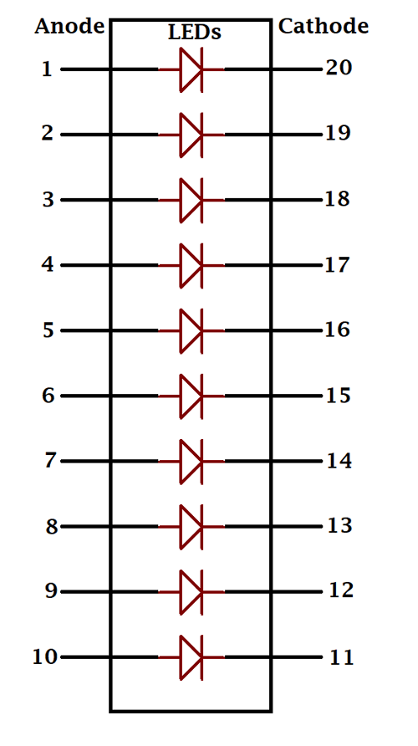
LED Bar graph
LED Bar Graph is an LED array, which is used to connect with electronic circuit or microcontroller. It’s easy to connect LED bar graph with the circuit like as connecting 10 individual LEDs with 10 output pins.
Applications :
Battery level Indicator
Audio equipments
Industrial Control panels
Moving Message Display
Digital Display

Slide 8
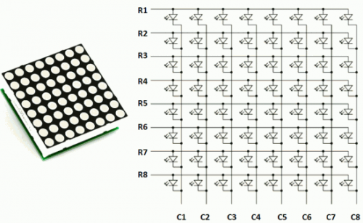
LED Dot Matrix
Unlike 7 segment displays dot matrix displays can be used to generate alpha, numeric, or custom character output.

Slide 9
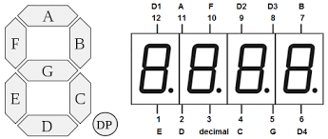
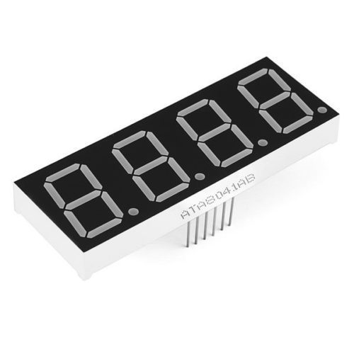
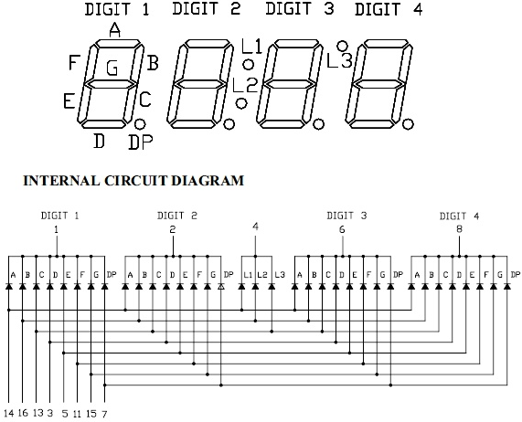
4 digit 7 segment display

Slide 10
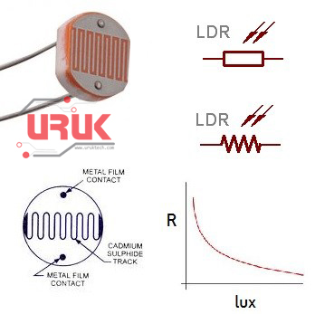
Light Dependent Resistor
An LDR is a component that has a (variable) resistance that changes with the light intensity that falls upon it. This allows them to be used in light sensing circuits.
Working principle: Photoconductivity
Tinkercad link:
https://www.tinkercad.com/things/k7eEjAOqL0Y-funky-borwo/editel?tenant=circuits

Slide 11
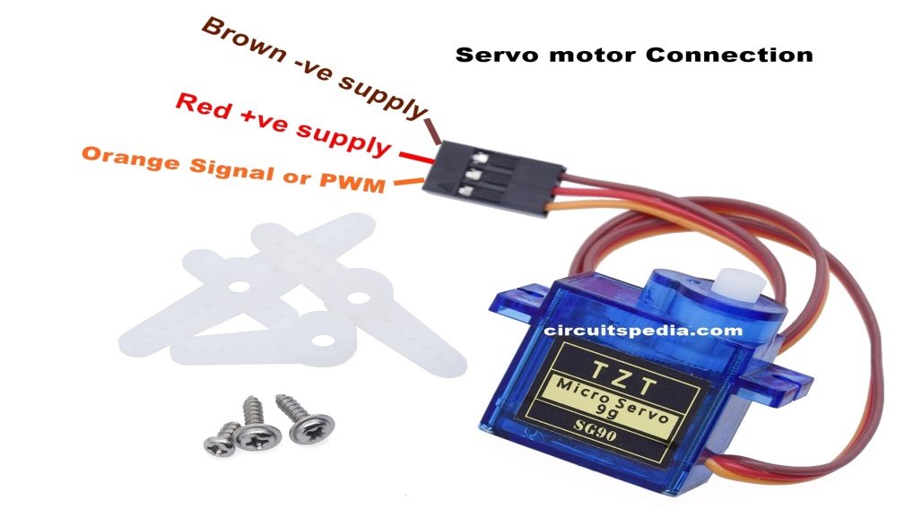
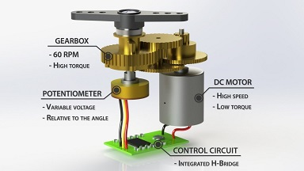
Servo Motor
A DC servo motor consists of a small DC motor, feedback potentiometer, gearbox, motor drive electronic circuit and electronic feedback control loop.
A servo (servomechanism) is an electromagnetic device that converts electricity into precise controlled motion by use of negative feedback mechanisms.

Slide 12
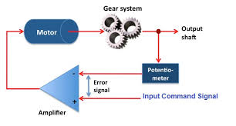
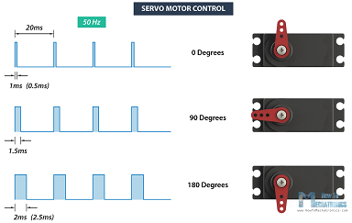
Servo motor closed loop system

Slide 13
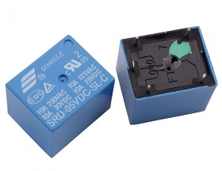
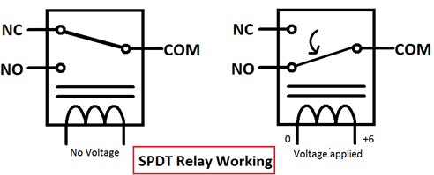
Relay
A relay is an electrically operated switch. It consists of a set of input terminals for a single or multiple control signals, and a set of operating contact terminals.
Internal structure of relay

Slide 14
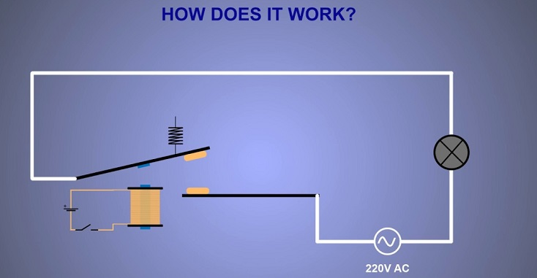

Slide 15
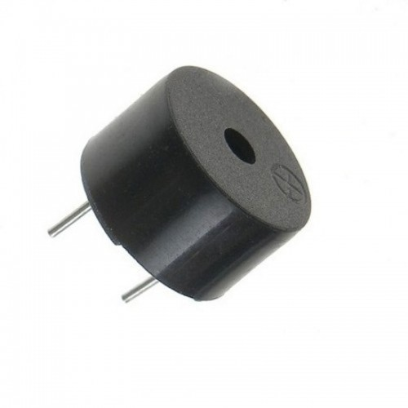
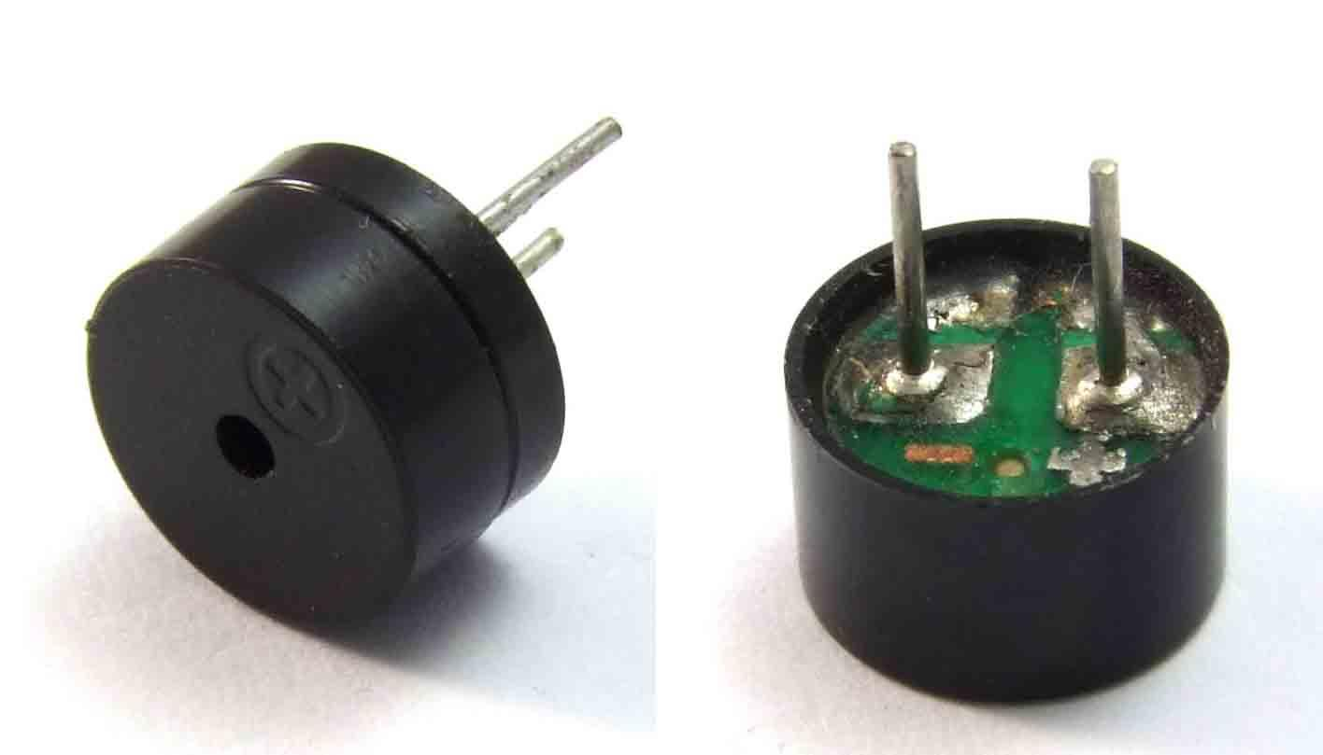
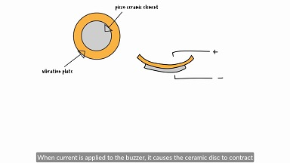
Buzzer
A buzzer or beeper is an audio signalling device, which may be mechanical, electromechanical, or piezoelectric (piezo for short). Typical uses of buzzers and beepers include alarm devices, timers, and confirmation of user input such as a mouse click or keystroke.
Working : They work by using a piezo crystal, a special material that changes shape when voltage is applied to it. If the crystal pushes against a diaphragm, like a tiny speaker cone, it can generate a pressure wave which the human ear picks up as sound.
https://www.tinkercad.com/things/jjoQqdmbWsf-shiny-lappi/editel?tenant=circuits

Slide 16
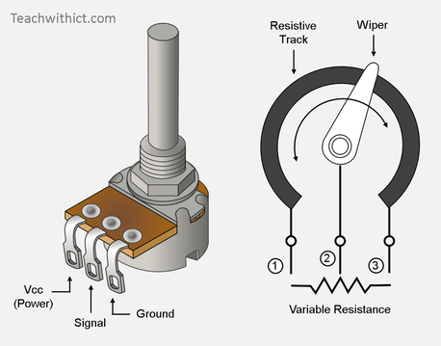
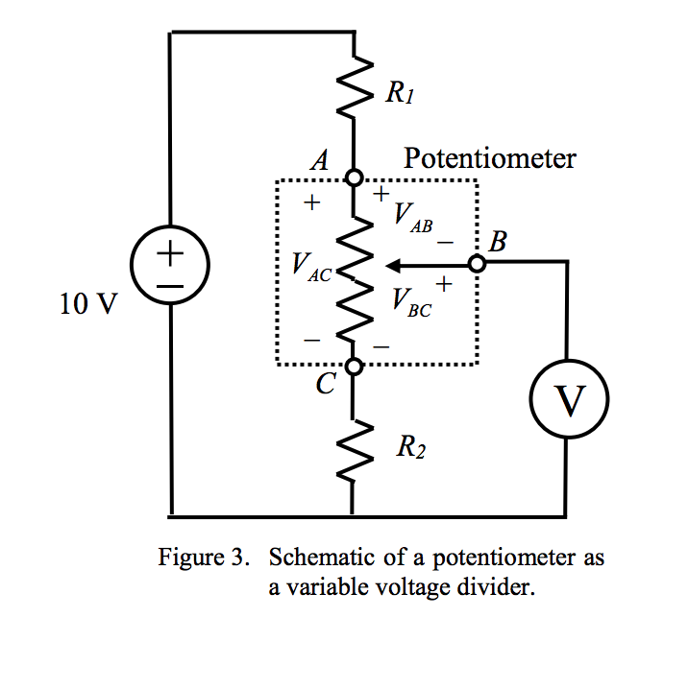
Potentiometer
A potentiometer is a three-terminal resistor with a sliding or rotating contact that forms an adjustable voltage divider. If only two terminals are used, one end and the wiper, it acts as a variable resistor or rheostat.
https://www.tinkercad.com/things/6CZLnp0NigK-epic-blorr/editel?tenant=circuits

Slide 17
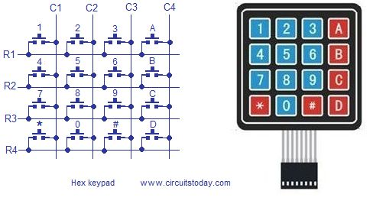
Keypad

